Slide 1



NYC RESTAURANTS
Delectable or Indigestible
Presented by: Newton Willis

Slide 2
Premise
New York City has a large number of restaurants offering a wide variety of cuisines.
Whereas most restaurants meet Department of Health and Mental Hygiene(DOHMH) inspection standards, a large number only qualify after repeated inspections.
The full scope and variety of cuisines are not available city wide.

Slide 3
Hypothesis
Most restaurants do not pass inspection on first inspection.
The majority of restaurants eventually attain the top rating and maintain high sanitary standards
Cuisines offered is varied.
Range of cuisines are not available throughout the city.

Slide 4
DATASET
SOURCE: Public Data - NYC Open Data
URL: https://data.cityofnewyork.us/Health/DOHMH-New-York-City-Restaurant-Inspection-Results/43nn-pn8j
Attributes 26
Records 400,011
Inspection Types 31 in eight categories
Violation codes 104
Scoring -1 and greater
Grade A < 14
Grade B 14 to 27
Grade C > 27

Slide 5
NYC Restaurants by the numbers
22192 Unique restaurant names city wide
399,418 Restaurants city wide
84 Cuisines

Slide 6
How many Restaurants are there in each Borough?
Number of restaurants
Manhattan - 157,477
Brooklyn - 101,663
Queens - 90,834
Bronx - 36,102
Staten Island - 13,342
Number of unique names
Manhattan - 8,859
Brooklyn - 6,082
Queens - 5,370
Bronx - 1,961
Staten Island - 867

Slide 7
Inspection Types
Pre-Permit Non-Operational
Initial Inspection
Re-Inspection
Compliance
Second Compliance
Pre-Permit Operational
Initial Inspection
Re-Inspection
Compliance
Second Compliance
Re-Opening

Slide 8
Inspection Types
Cycle
Initial Inspection
Re-Inspection
Compliance
Second Compliance
Re-Opening
Administrative
Initial Inspection
Re-Inspection
Compliance
Second Compliance
Re-Opening

Slide 9
Inspection Types
Calorie Posting
Initial Inspection
Re-Inspection
Compliance
Smoke Free Air Act
Initial Inspection
Re-inspection
Compliance
Limited

Slide 10
Inspection Types
Trans Fat
Initial Inspection
Re-inspection
Compliance
Second Compliance
Inter-Agency Task Force
Initial Inspection

Slide 11
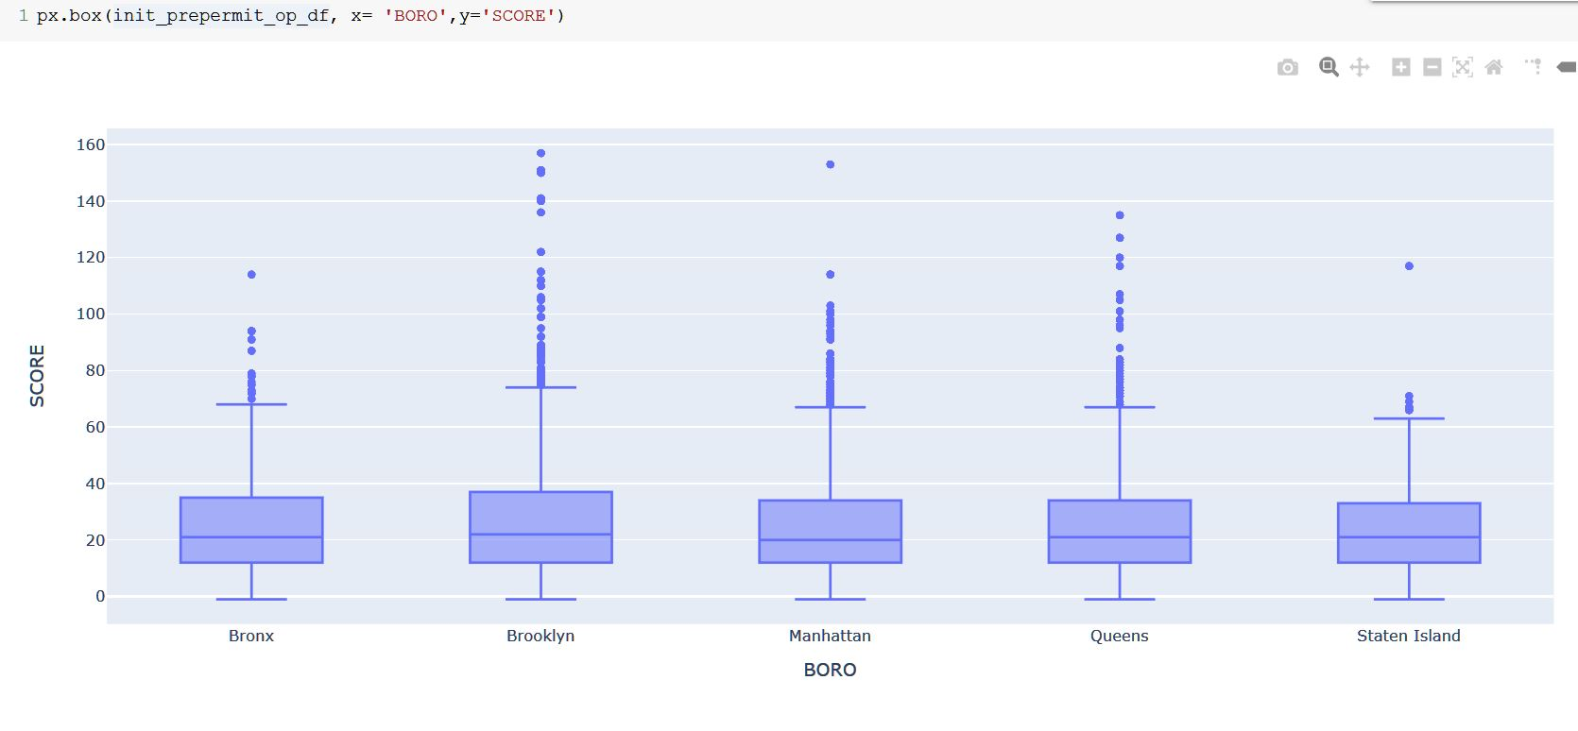
Inspection Analysis
Pre-permit Operational Initial Inspection

Slide 12
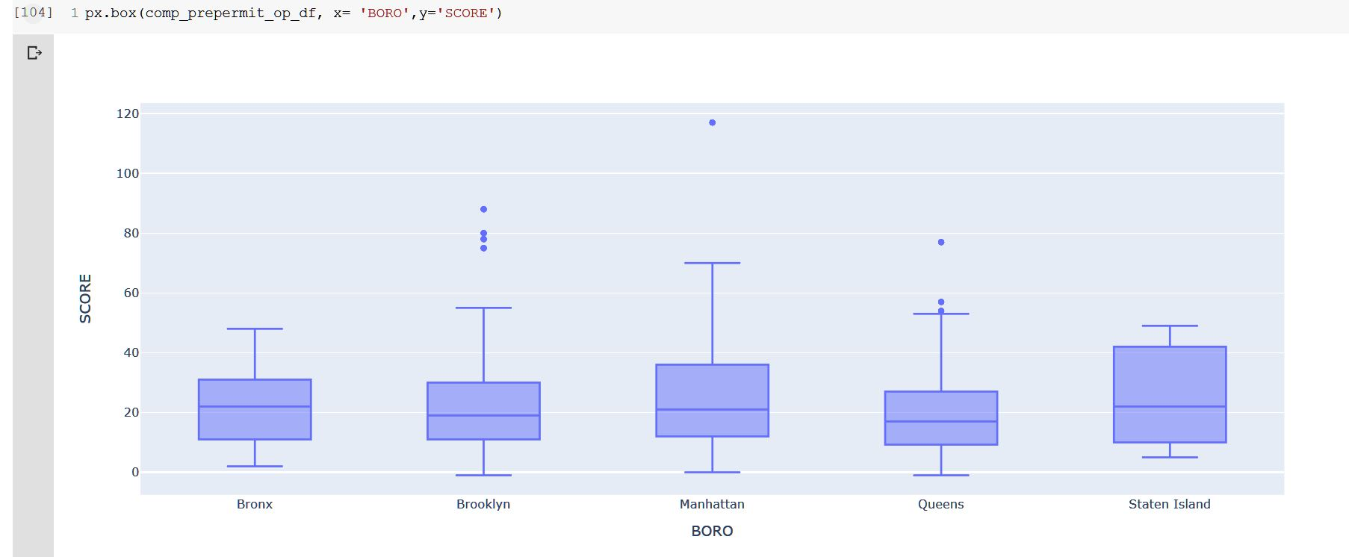
Inspection Analysis
Pre-permit Operational Compliance Inspection

Slide 13
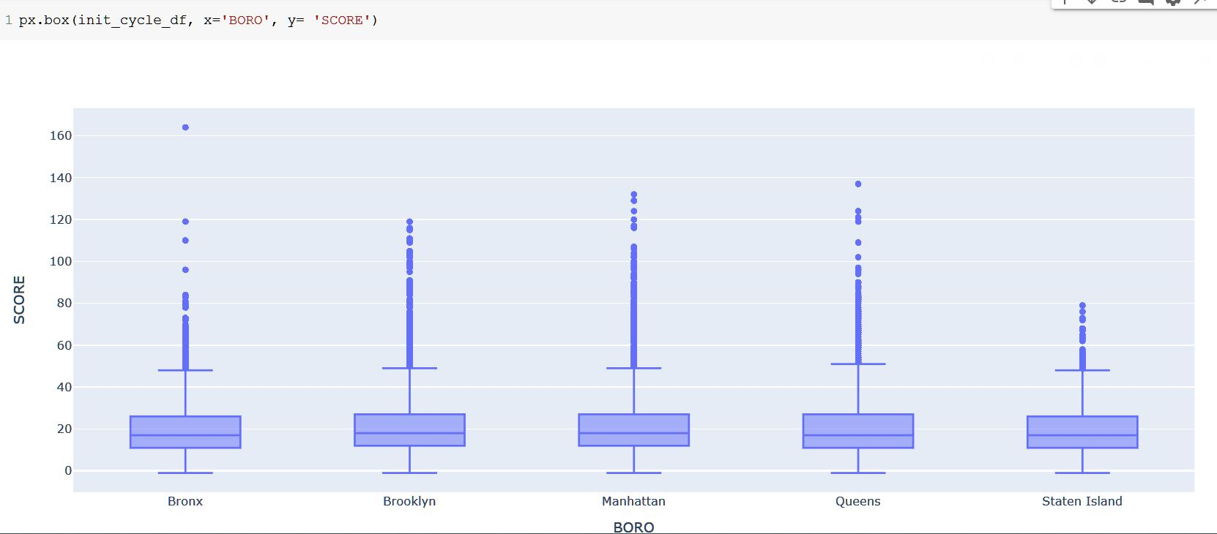
Inspection Analysis
Cycle Initial Inspection

Slide 14
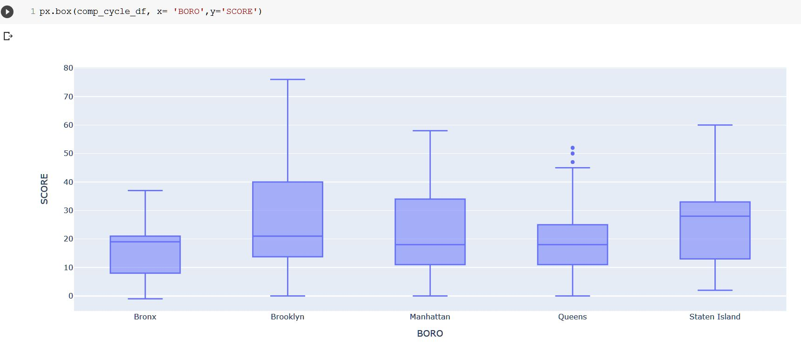
Inspection Analysis
Cycle Compliance Inspection

Slide 15
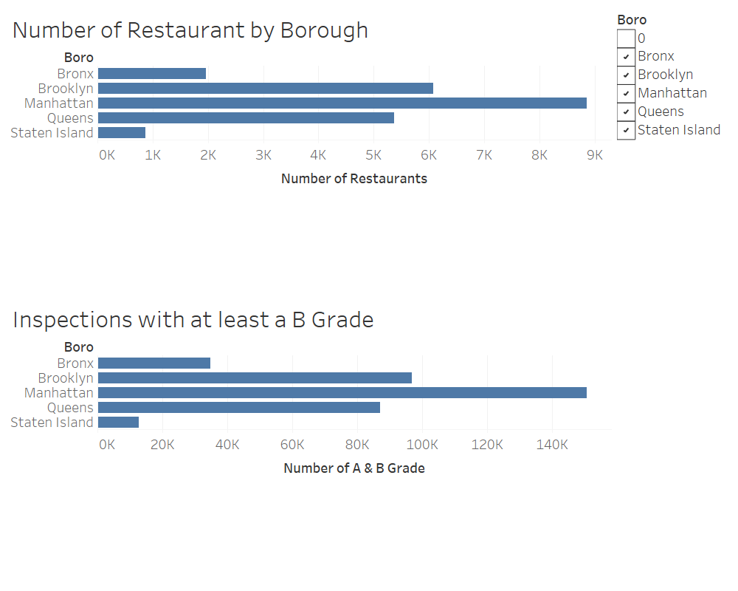

Slide 16
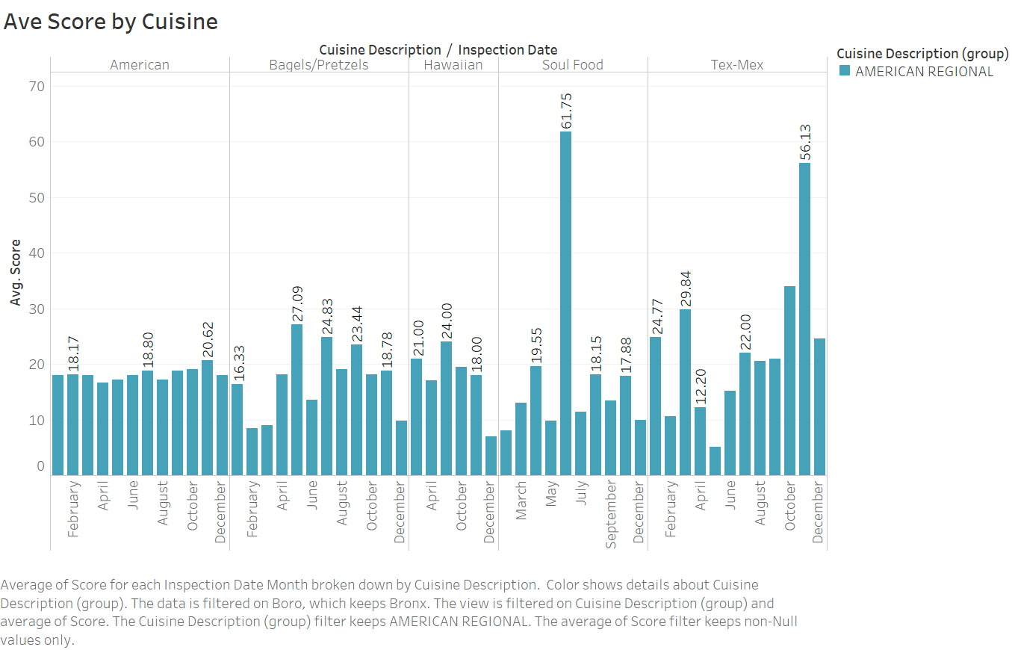

Slide 17
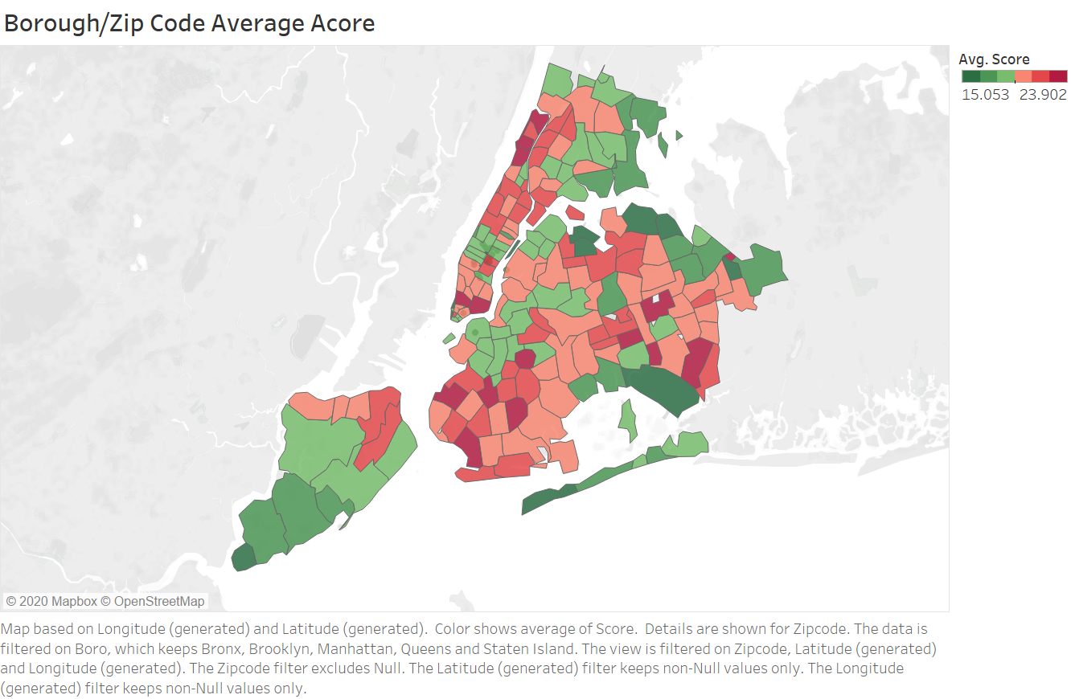

Slide 18
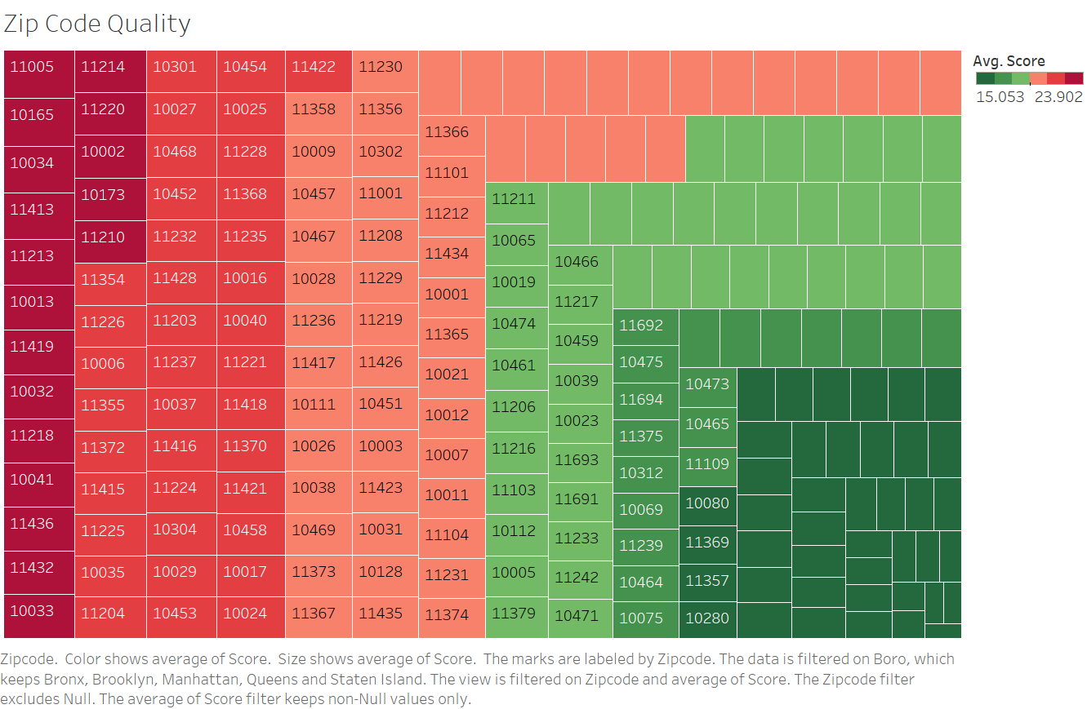

Slide 19
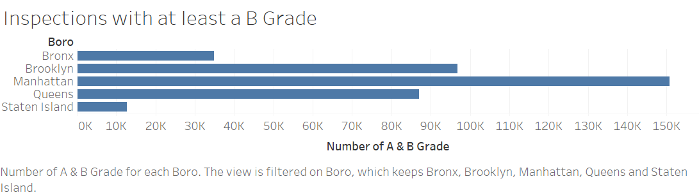

Slide 20
Conclusion
Hptothesis – True of False
Most restaurants do not pass inspection on first inspection. FALSE
The majority of restaurants eventually attain the top rating and maintain high sanitary standards TRUE?
Cuisines offered is varied. TRUE
Range of cuisines are not available throughout the city FALSE

Slide 21

The End
Bon Appetit!!

